Slide 1
Judging a Book
By Its Plugins:
A Static-Analysis Security Evaluation of Calibre
CollinHatcher
Kevin Rodriguez

Slide 2
Project Overview
Scope: Provide a comprehensive security assessment of Calibre’s plugin architecture.
Goals: Identify potential plugin vulnerabilities using formal threat modeling and static analysis.
Outcome: Provide an evidence-based report and security recommendations to improve Calibre’s security and protect user data.
About Calibre
What is it: Popular cross-platform e-book manager.
Plugin System: Supports user-installed plugins to extend functionality.
Why Calibre?: Widely used tool with a large user base. The plugin architecture is a prime candidate for uncovering potential security vulnerabilities.

Slide 3
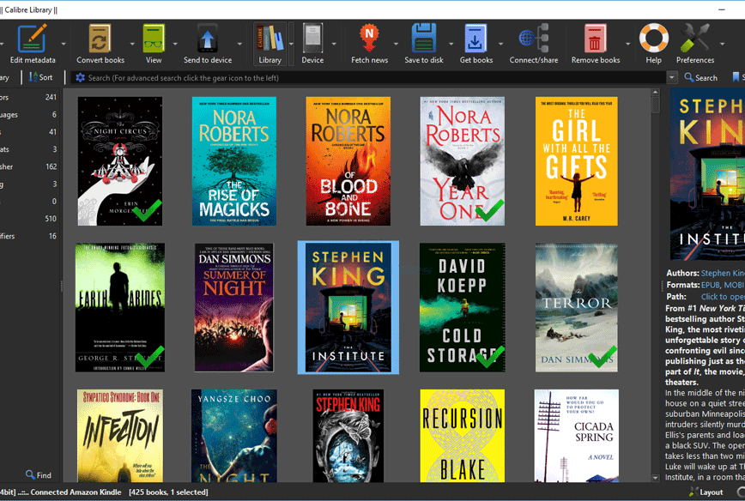
Calibre E-book Management
Free open-source cross-platform digital library manager. It has over 5 million downloads in 2023
Comprehensive e-book viewer
Can integrate with several e-reader devices.
Manage e-book library
Download, share, edit, and back up books/news/magazines easily
Customizable and user-friendly
Hundreds of user-developed plugins to enhance and expand Calibre’s features

Slide 4
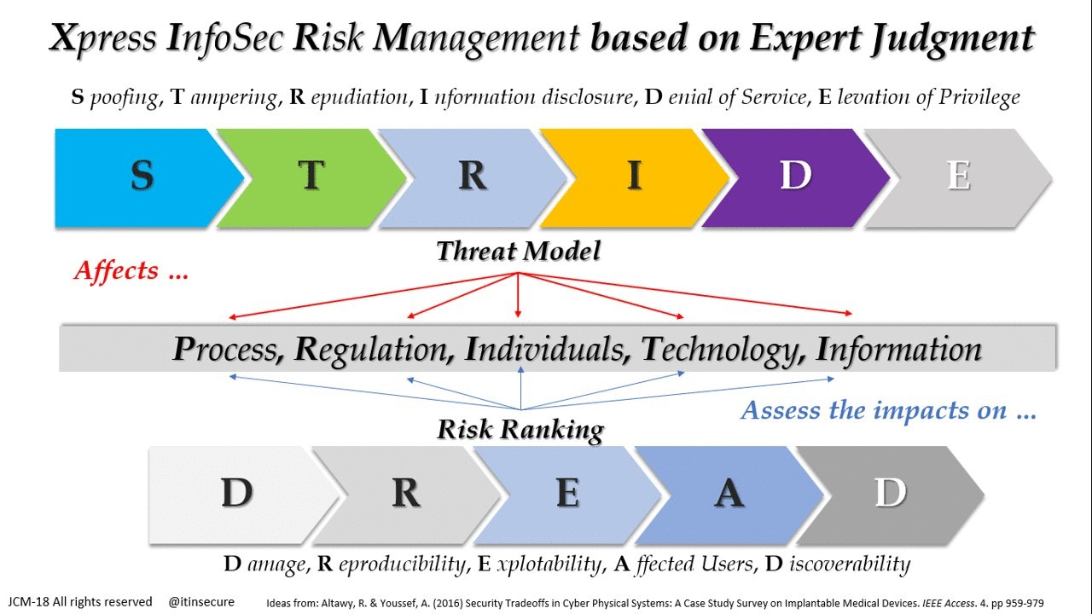
Threat Model & Attacker Roles
Modelling Approach
Applied STRIDE to identify threat categories.
Applied DREAD to score and prioritize each threat.
Malicious Plugin Authors
Remote Attacker
Local Attacker
This attacker creates and distributes malicious plugin code containing vulnerabilities with the goal to gain unauthorized access to data or disrupt services.
This attacker aims to target the network capability of Calibre’s plugin systems. Their goal is to identify vulnerable network endpoints for further malicious actions.
This attacker is defined as someone who can access a local user's machine with the goal of tampering with plugins.

Slide 5
Testing Setup
Environment Setup
Plugin File Identification
Static Analysis: Pylint
All static analyses were performed inside an isolated Ubuntu VM
A Python script was created to scan the repository recursively for plugin files.
Pylint is a linter used to analyze code for standard coding practices, code complexity, and insecure processes. It grades code errors as “convention”, “refactor”, ”warning”, and “errors/fatal errors” with a score of 1, 2, 3, and 4, respectively.
Test Execution
After identifying plugin-related files, Bandit and Pylint were used to identify and evaluate the code.
Source Code
Static Analysis: Bandit
To ensure repeatable results, we cloned Calibre’s GitHub repository
Bandit is a static type checker to verify variables and functions are used correctly. Classifies vulnerabilities as low, medium, or high scoring them as 1, 2, and 3 respectfully

Slide 6

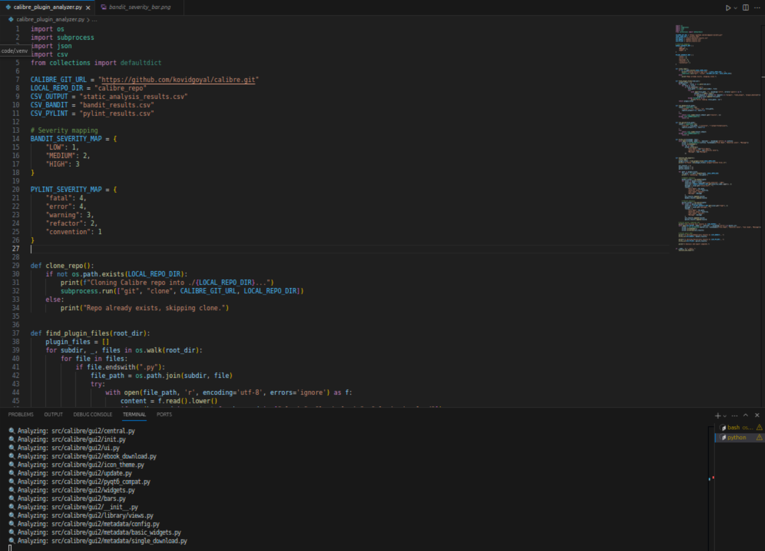
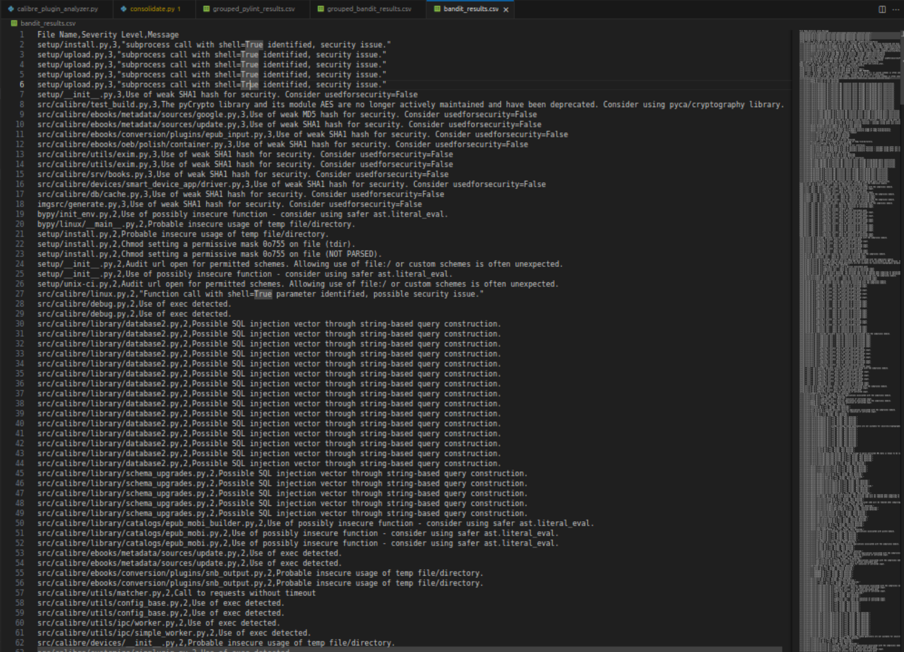
Initial Scans
Locate
Scan
Analyze
Our Initial run found 319 plugin-related files and scanned them with Pylint and Bandit
Resulted in over 23,000 hits combined
We wanted to find the most critical areas within Calibre's plugin system so we consolidated our data ...

Slide 7
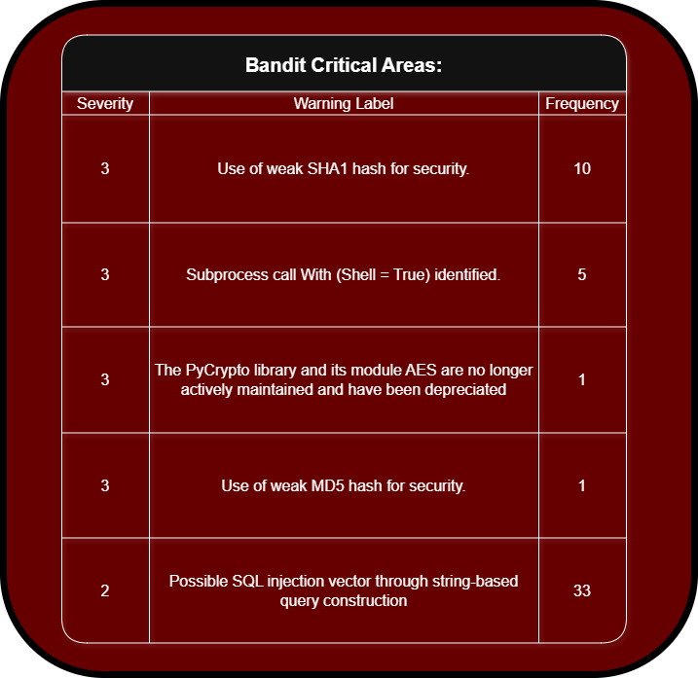

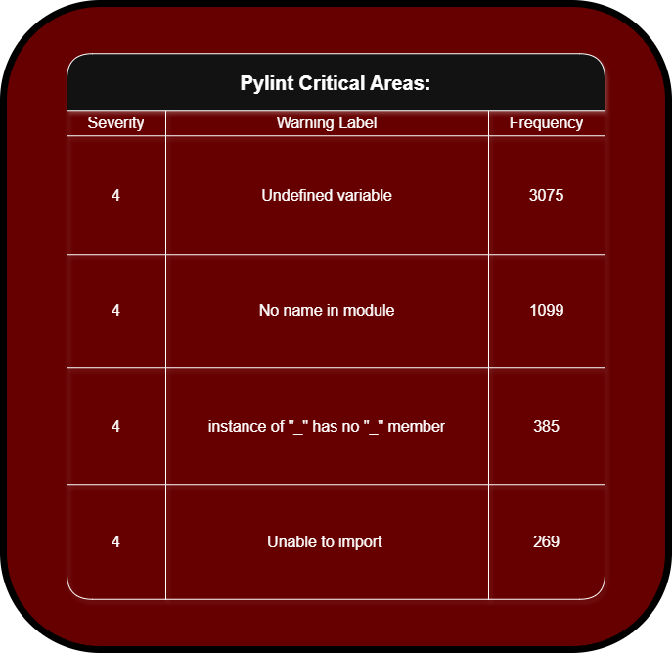
Findings:
vulnerabilities & misconfigurations
Security Threats
Misconfigurations
Consolidated
Results
Cryptographic weaknesses were found due to the use of outdated hashing algorithms like SHA1 and MD5, which are susceptible to collision attacks
The use of shell=True in subprocess calls introduces a risk of shell injection, especially if tied to user input
Reliance on the deprecated PyCrypto library exposes the system to known security flaws
Raw string formatting in SQL queries opens the door to SQL injection attacks
invalid or deprecated imports
Attempts to access nonexistent object attributes
Undefined Variables
Unresolved module configurations
=========================
These issues can cause runtime crashes, broken plugin functionality, or failure to load key components, all of which reduce system reliability and increase the attack surface.

Slide 8

Proposed Mitigations
Secure Configuration Tips
Code/Design Changes
Disabling the “Allow installing from untrusted sources” option prevents unverified plugins downloads and updates.
Users should routinely verify that they are current on all software and security updates
Introducing a permission-based system with strong authentication to monitor and restrict plugin actions.
Adding an official plugin repository for monitoring and vetting.
Plugin Security Suggestion
Adding a ”required reading” for all plugin authors. Can include guidelines of secure coding practices or a plugin's rulebook.
The goal is to enhance security without compromising customizability.

Slide 9

Conclusion
Assessment Summary
Our analysis revealed over 22,000 Pylint messages and 462 Bandit security warnings, highlighting both minor issues and critical security flaws.
Bandit exposed vulnerabilities such as weak cryptographic algorithms, areas where unwanted shell command execution may be present, import errors that indicate weak runtime errors, and areas that may be open to SQL injections, to name a few.
Takeaway
Calibre’s flexible plugin system is core to its appeal but represents one of its most significant security challenges. Our analysis shows that the plugin system can become a large surface area for attacks and system instability without careful management.

Slide 10
THANK YOU

